Slide 1
Lecture 28
IEEE 1149.1 JTAG
Boundary Scan Standard
Motivation
Bed-of-nails tester
System view of boundary scan hardware
Elementary scan cell
Test Access Port (TAP) controller
Boundary scan instructions
Summary

Slide 2
Motivation for Standard
Bed-of-nails printed circuit board tester gone
  We put components on both sides of PCB & replaced DIPs with flat packs to reduce inductance
    Nails would hit components
  Reduced spacing between PCB wires
    Nails would short the wires
  PCB Tester must be replaced with built-in test delivery system -- JTAG does that
  Need standard System Test Port and Bus
  Integrate components from different vendors
    Test bus identical for various components
    One chip has test hardware for other chips

Slide 3
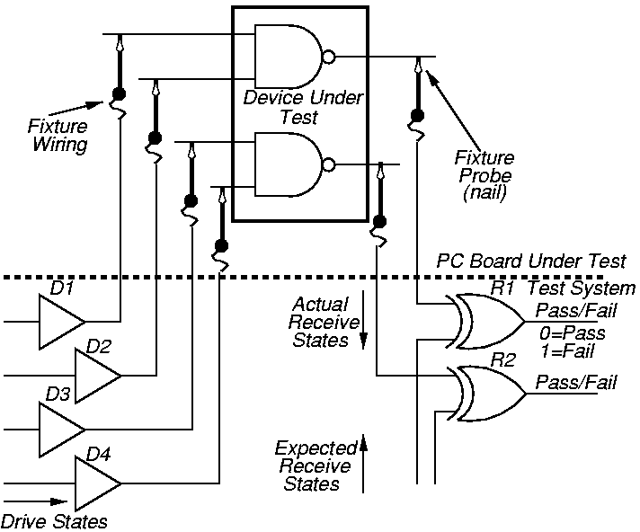
Bed-of-Nails Tester Concept

Slide 4
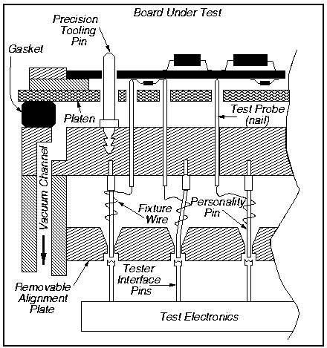
Bed-of-Nails Tester

Slide 5
Purpose of Standard
Lets test instructions and test data be serially fed into a component-under-test (CUT)
  Allows reading out of test results
  Allows RUNBIST command as an instruction
    Too many shifts to shift in external tests
JTAG can operate at chip, PCB, & system levels
Allows control of tri-state signals during testing
Lets other chips collect responses from CUT
Lets system interconnect be tested separately from components
Lets components be tested separately from wires

Slide 6
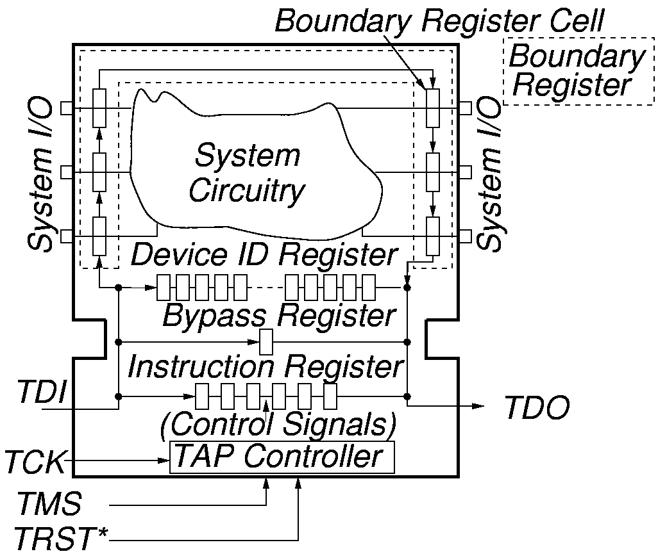
System Test Logic

Slide 7
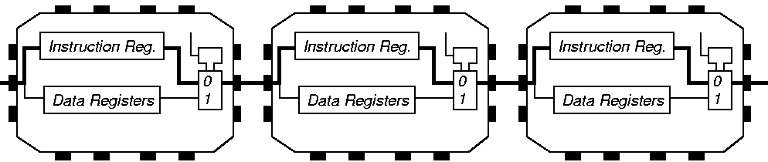
Instruction Register Loading with JTAG

Slide 8
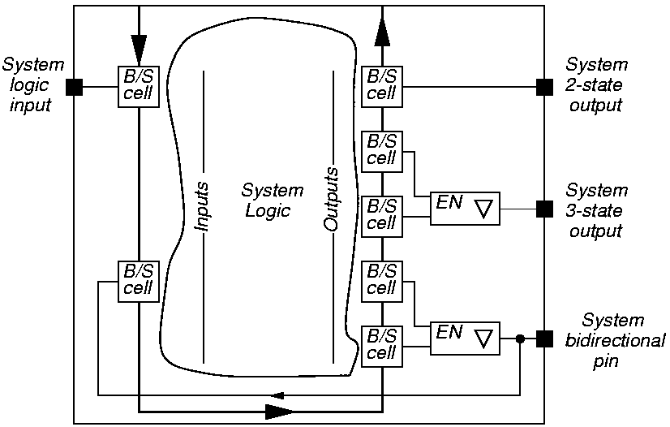
System View of Interconnect

Slide 9
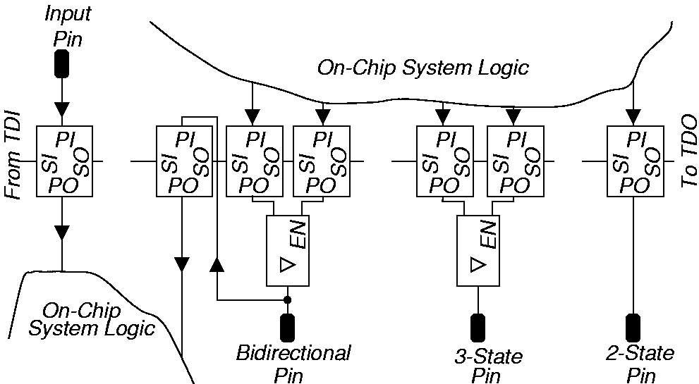
Boundary Scan Chain View

Slide 10
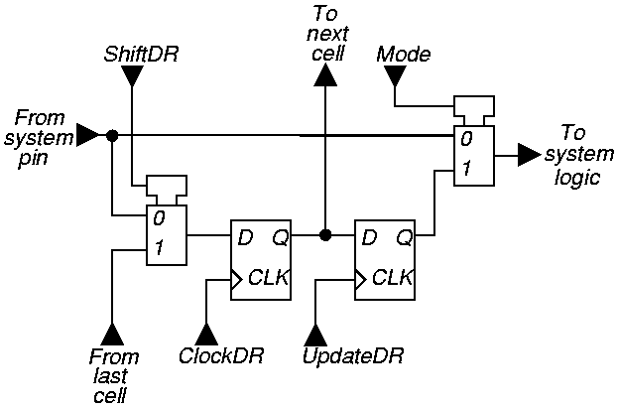
Elementary Boundary Scan Cell

Slide 11
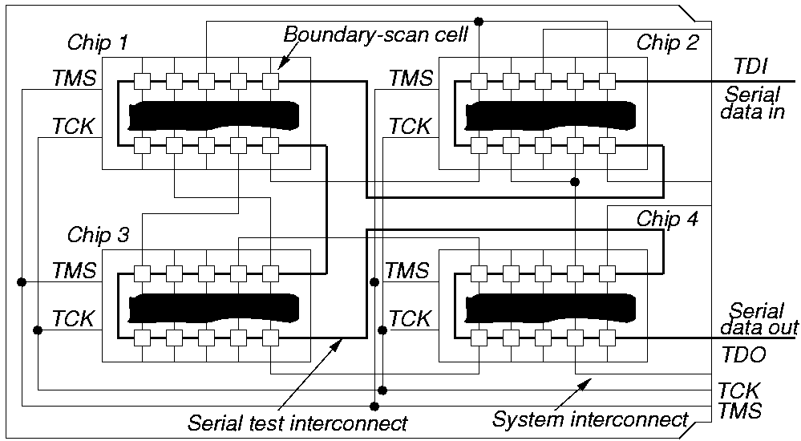
Serial Board / MCM Scan

Slide 12
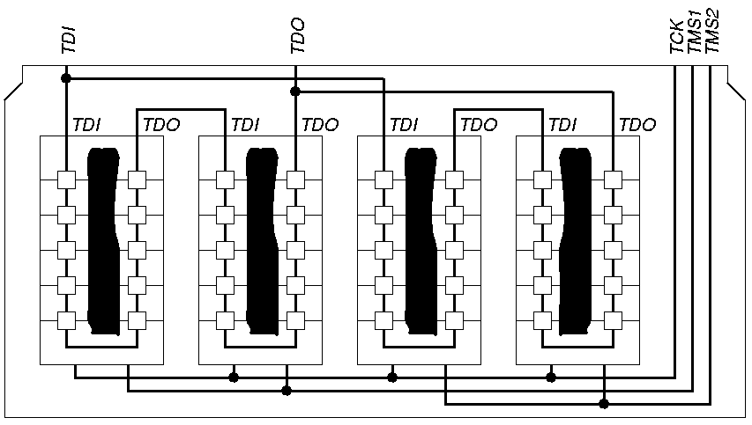
Parallel Board / MCM Scan

Slide 13
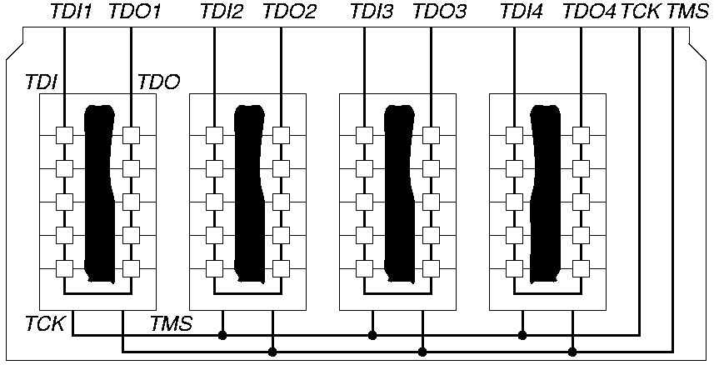
Independent Path Board / MCM Scan

Slide 14
Tap Controller Signals
Test Access Port (TAP) includes these signals:
  Test Clock Input (TCK) -- Clock for test logic
    Can run at different rate from system clock
  Test Mode Select (TMS) -- Switches system from functional to test mode
  Test Data Input (TDI) -- Accepts serial test data and instructions -- used to shift in vectors or one of many test instructions
  Test Data Output (TDO) -- Serially shifts out test results captured in boundary scan chain (or device ID or other internal registers)
  Test Reset (TRST) -- Optional asynchronous TAP controller reset

Slide 15
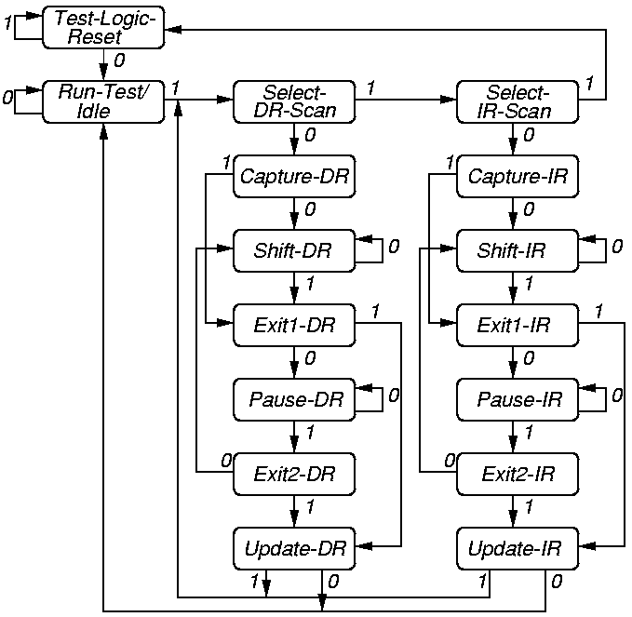
Tap Controller State Diagram

Slide 16
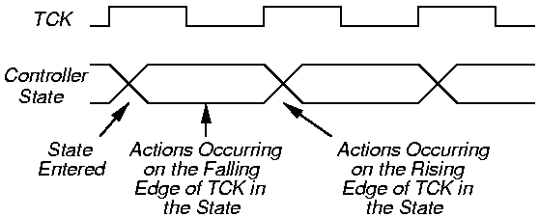
Tap Controller Timing

Slide 17
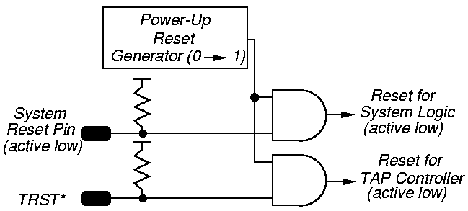
TAP Controller Power-Up Reset Logic

Slide 18
Boundary Scan Instructions

Slide 19
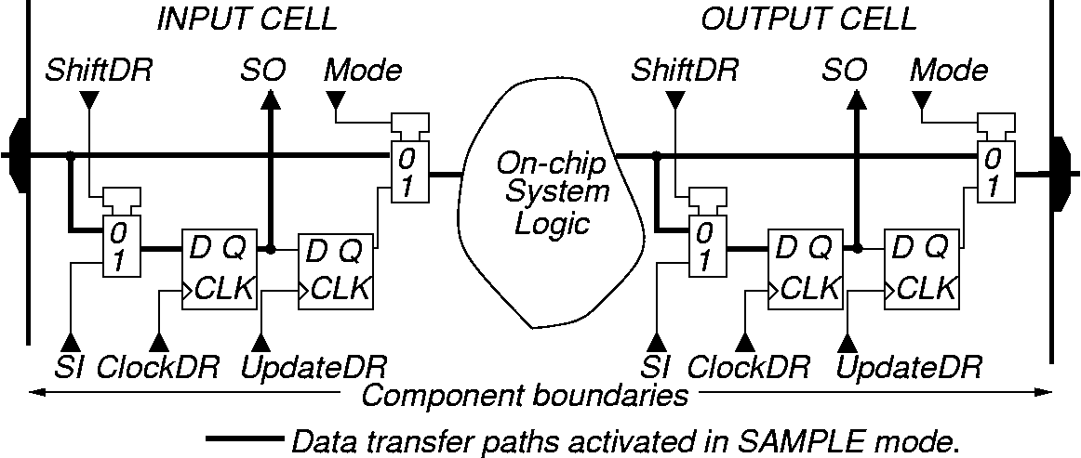
SAMPLE / PRELOAD Instruction -- SAMPLE
Purpose:
Get snapshot of normal chip output signals
Put data on bound. scan chain before next instr.

Slide 20
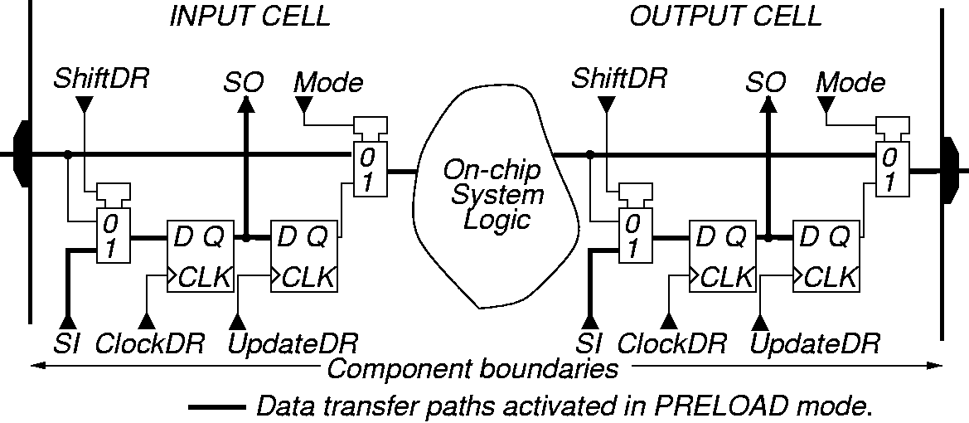
SAMPLE / PRELOAD Instruction -- PRELOAD

Slide 21
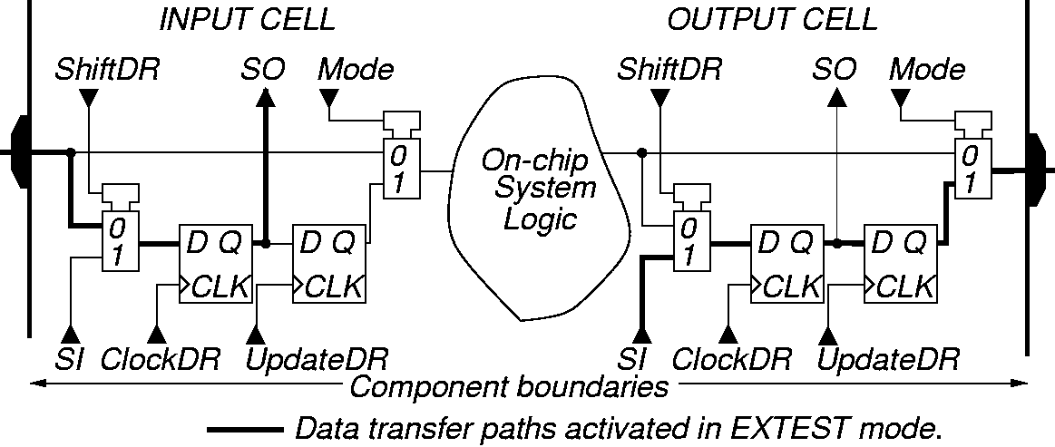
EXTEST Instruction
Purpose: Test off-chip circuits and board-level interconnections

Slide 22
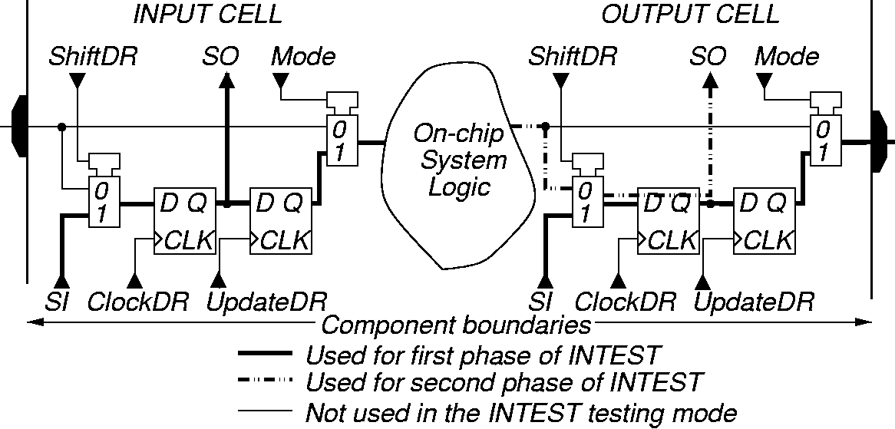
INTEST Instruction
Purpose:
  Shifts external test patterns onto component
  External tester shifts component responses out

Slide 23
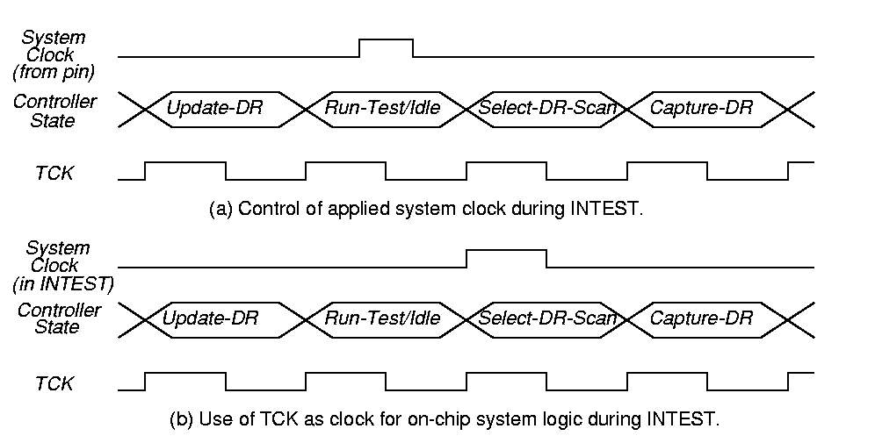
INTEST Instruction Clocks
Control of applied system clock during INTEST
Use of TCK for on-chip system logic clock

Slide 24
RUNBIST Instruction
Purpose: Allows you to issue BIST command to component through JTAG hardware
Optional instruction
Lets test logic control state of output pins
  Can be determined by pin boundary scan cell
  Can be forced into high impedance state
BIST result (success or failure) can be left in boundary scan cell or internal cell
  Shift out through boundary scan chain
May leave chip pins in an indeterminate state (reset required before normal operation resumes)

Slide 25
CLAMP Instruction
Purpose: Forces component output signals to be driven by boundary-scan register
Bypasses the boundary scan chain by using the one-bit Bypass Register
Optional instruction
May have to add RESET hardware to control on-chip logic so that it does not get damaged (by shorting 0’s and 1’s onto an internal bus, etc.)

Slide 26
IDCODE Instruction
Purpose: Connects the component device identification register serially between TDI and TDO
  In the Shift-DR TAP controller state
Allows board-level test controller or external tester to read out component ID
Required whenever a JEDEC identification register is included in the design

Slide 27
Device ID Register --JEDEC Code
MSB
LSB
31 28
Version
(4 bits)
27 12
Part
Number
(16 bits)
11 1
Manufacturer
Identity
(11 bits)
0
‘1’
(1 bit)

Slide 28
USERCODE Instruction
Purpose: Intended for user-programmable components (FPGA’s, EEPROMs, etc.)
  Allows external tester to determine user programming of component
Selects the device identification register as serially connected between TDI and TDO
User-programmable ID code loaded into device identification register
  On rising TCK edge
Switches component test hardware to its system function
Required when Device ID register included on user-programmable component

Slide 29
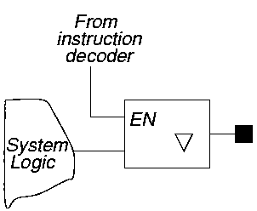
HIGHZ Instruction
Purpose: Puts all component output pin signals into high-impedance state
Control chip logic to avoid damage in this mode
May have to reset component after HIGHZ runs
Optional instruction

Slide 30
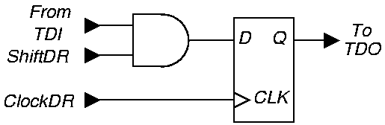
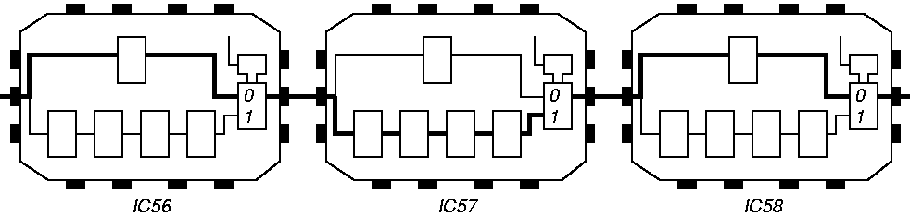
BYPASS Instruction
Purpose: Bypasses scan chain with 1-bit register

Slide 31
Optional / Required Instructions
Instruction
BYPASS
CLAMP
EXTEST
HIGHZ
IDCODE
INTEST
RUNBIST
SAMPLE / PRELOAD
USERCODE
Status
Mandatory
Optional
Mandatory
Optional
Optional
Optional
Optional
Mandatory
Optional

Slide 32
Summary
Boundary Scan Standard has become absolutely essential --
  No longer possible to test printed circuit boards with bed-of-nails tester
  Not possible to test multi-chip modules at all without it
  Supports BIST, external testing with Automatic Test Equipment, and boundary scan chain reconfiguration as BIST pattern generator and response compacter
  Now getting widespread usage

